Slide 1
SWEG2071
Web Design and Programming
SWENG
AASTU
March 2018

Slide 2
Chapter - 4
Cascading Style Sheets (CSS)

Slide 3
Content
Introduction
Levels of style sheets
Style specification formats
Properties – font, list, color, text alignment, background images

Slide 4
Introduction
Consider the management of a corporate web site
  Site identity (look & feel ) must be maintained
  Changes in site identity must be implemented across the entire site
HTML necessarily mixes style and content, but Cascading Style Sheet(CSS) separate content from its presentation
  Content: what to display
  Presentation: how to display
  Will be simple to answer those questions:
    can you make all the text in the app slightly bigger?
    Or purple is our new company color.
  Saves a lot of work
    Especially in website maintenance and upgrading

Slide 5
CSS
CSS provides the means to control and change presentation of HTML documents
Style sheets allow you to impose a standard style on a whole document, or even a whole collection of documents
CSS1 specification – 1996
CSS2 specification - 1998
CSS level 2 revision 1 (“CSS 2.1”)
CSS3 –current standard

Slide 6
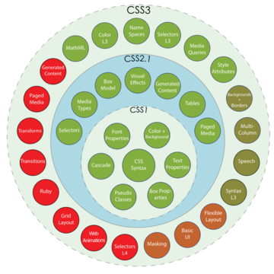


Slide 7
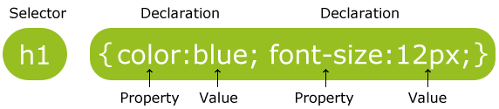
CSS Syntax
  CSS consists of two main parts: a selector(element name), and one or more declarations
  Format:
    selector { property1 : value1;property2: value 2;… }
  declaration
    Declaration consists of a property and a value, and are separated by a colon.
    The property is the style attribute you want to change. Each property has a value.
    A CSS declaration always ends with a semicolon, and declaration groups are surrounded by curly brackets:
      The selector is normally the HTML element you want to style.
      Selectors can be grouped (separated by comma)
    Ex. p, div, table { align: center; }

Slide 8
Types of Selectors
  Types of selectors:
    HTML tag names
    Class selectors
    Generic selectors
    Id selectors
    Universal selectors
  HTML tag names as selectors
    used to override the default attributes of HTML tags
  Format: tag_name {property : value}
  E.g. a { color: red;
  text-decoration: overline;
  }

Slide 9
Class Selector
You can define style rules based on the class attribute of the elements. All the elements having that class will be formatted according to the defined rule.
Format: tag_name.style_name { property: value }
  E.g. p.somecolor {color: green }
  <p class=“somecolor”>some text</p>

Slide 10
Generic Selectors
A generic class can be defined if you want a style to apply to more than one kind of tag
A generic class must be named, and the name must begin with a period
  .really-big { … }
Use in body of doc like normal style class
<h1 class = "really-big"> … </h1>
...
<p class = "really-big"> … </p>

Slide 11
id Selectors
An id selector allow the application of a style to one specific element
General form:
  #specific-id {property-value list}
e.g. #section3 {font-size: 20}
In HMTL doc:
<h2 id = “section3”>
3. Properties for sale
</h2>

Slide 12
Universal Selectors
The universal selector, denoted by an asterisk (*), applies its style to all elements in a document. E.g:
  * {color: red;}
makes all elements in the document red.
The universal selector is not often useful.

Slide 13

Pseudo Classes
Pseudo classes are styles that apply when something happens, rather than because the target element simply exists
Names begin with colons
hover class applies when the mouse cursor is over the element
focus class applies when an element has focus
..\lectures\Examples\pseudo.html

Slide 14
Levels of Style Sheets
There are three levels of style sheets
Inline - specified for a specific occurrence of a tag and apply only to that tag
  This is fine-grain style, which defeats the purpose of style sheets - uniform style
  Deprecated
Document-level style sheets - apply to the whole document in which they appear
External style sheets - can be applied to any number of documents
When more than one style sheet applies to a specific tag in a document, the lowest level style sheet has precedence

Slide 15
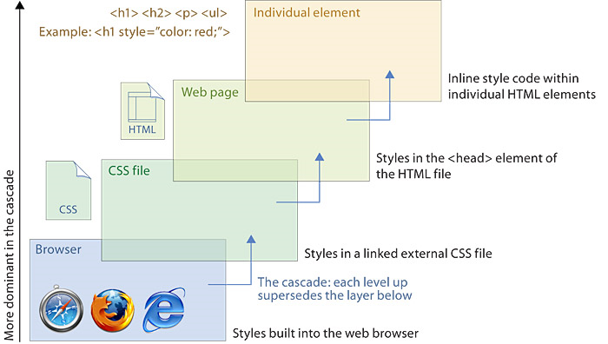
CSS cascade hierarchy
From Web Style Guide: Basic Design Principles for Creating Web Sites

Slide 16
Inline Styles
An inline style loses many of the advantages of style sheets by mixing content with presentation. Use this method sparingly!
To use inline styles you use the style attribute in the relevant tag. The style attribute can contain any CSS property.
    <tag_name style=“property:value; property: value;”> … </tag_name>
    E.g. <table style=“background-color: yellow”>… </table>
The example shows how to change the color and the left margin of a paragraph:
<p style="color:sienna;margin-left:20px">This is a paragraph.</p>

Slide 17
Internal Style Sheet
An internal style sheet should be used when a single document has a unique style. You define internal styles in the head section of an HTML page, by using the <style> tag, like this:
defined in the <head> element
  <style type=“text/css”>
  {property:value; ...}
  </style>
Eg:
<head>
<style type =“text/css”>
hr {color:sienna;}
p {margin-left:20px;}
body {background-image:url("images/back40.gif");}
</style>
</head>

Slide 18
Example: Internal Style
<html>
  <head>
  <title>Using Internal CSS</title>
  <style type="text/css">
  .center {text-align:center;}
  </style>
  </head>
  <body>
    <h1 class=“center">Potatoes</h1>
    <p class="center">There are dozens of different potato
    varieties. They are usually described as
    early, second early and maincrop.</p>
    <h2 >Types of Potatoes</h2>
    <p class="center">Secod Pargraph.......... </p>
  </body>
</html>

Slide 19
External Style Sheet
An external style sheet is ideal when the style is applied to many pages. With an external style sheet, you can change the look of an entire Web site by changing one file.
Each page must link to the style sheet using the <link> tag. The <link> tag goes inside the head section:
  defined in a separate CSS file
  linked to an HTML document using the <link> tag, tell the browser where to find the CSS file used to style the page.
  <link rel=“stylesheet” type=“text/css” href=“url”>
  changes to the styles in the external CSS file will be automatically reflected in all the HTML document in which the style is attached

Slide 20
External Style Sheet(cont’d)
Attributes:
  href
    This specifies the path to the CSS file (which is often placed in a folder called css or styles).
  type
    This attribute specifies the type of document being linked to. The value should be text/css.
  rel
    This specifies the relationship between the HTML page and the file it is linked to. The value should be stylesheet when linking to a CSS file.
An external style sheet can be written in any text editor. The file should not contain any html tags. Your style sheet should be saved with a .css extension.
Do not add a space between the property value and the unit (such as margin-left:20 px). The correct way is: margin-left:20px
An HTML page can use more than one CSS style sheet. To do this it could have a <link> element for every CSS file it uses. For example, some authors use one CSS file to control the presentation (such as fonts and colors) and a second to control the layout.

Slide 21
Example: External Style
HTML File: save as “ExternalCSSEg.html”
----------------------------------------------------
  <html>
  <head>
  <title>Introducing CSS</title>
  <link href=“example.css" type="text/css" rel="stylesheet" />
  </head>
  <body>
  <h1>From Garden to Plate</h1>
  <p>A <i>potager</i> is a French term for an
  ornamental vegetable or kitchen garden ... </p>
  <h2>What to Plant</h2>
  <p>Plants are chosen as much for their functionality
  as for their color and form ... </p>
  </body>
  </html>

Slide 22
Example(cont’d)
CSS File: Save as “example.css”
---------------------------------------------------------
body {
font-family: Arial;
}
h1, h2 {
color: #ee3e80;
}
p {
color: #2255FF;
}

Slide 23
Properties
CSS has many properties in categories like:
Fonts
Lists
Alignment of text
Margins
Colors
Backgrounds
Borders

Slide 24
Property Value Forms
Length - specified as number values that are followed immediately by a two-character abbreviation of a unit name
  Units:
    px – pixels
    in – inches
    cm – centimeters
    mm – millimeters
    pt – points(a point is 1/72 inch)
    pc - picas (12 points)
    em - height of the letter ‘m’
    ex-height - height of the letter ‘x’
  No space is allowed between the number and the unit specification, e.g. 1.5 in is illegal!

Slide 25
Property Value Forms
Percentage - just a number followed immediately by a percept sign
Colors
  Color name, e.g. white
  Hex form: #XXXXXX, e.g. #FFFFFF
  rgb(n1, n2, n3), e.g. rgb(255, 255, 255)
    Numbers can be decimal (0-255) or percentages
Property values are inherited by all nested tags, unless overridden. E.g:
body {font-size: 16pt}

Slide 26
Font Properties
To style texts, virtually all HTML documents include text
font-family
  Value is a list of font names - browser uses the first in the list it that it supports e.g
font-size
  Possible values: a length number(e.g. 40px) or a name, such as smaller, xx-large, etc.
font-style
  italic, oblique (useless), normal
font-weight - degrees of boldness
  Values for the property range from 100 to 900, in increments of 100. Keywords also are supported, including bolder, lighter, bold, normal
font - for specifying a list of font properties, shorthand
  font: bolder 14pt Arial Helvetica
  Order must be: style, weight, size, font name(s)
font-family: Arial, Helvetica, Futura

Slide 27
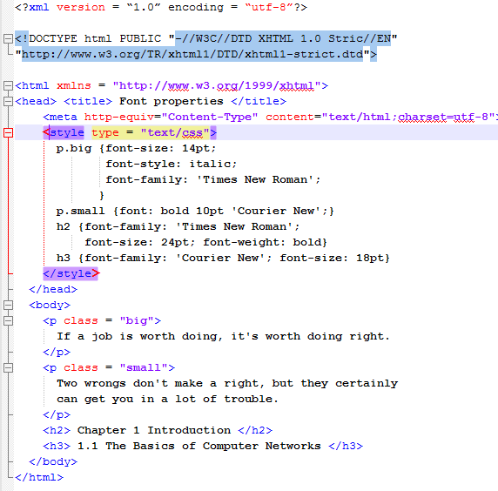
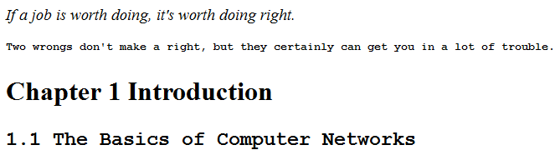
Example-document style sheet

Slide 28
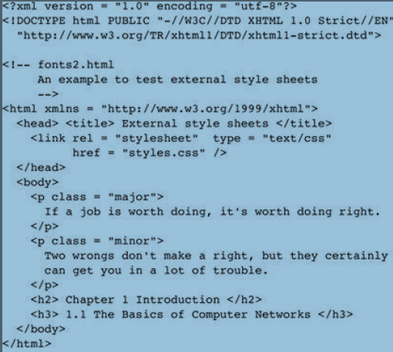
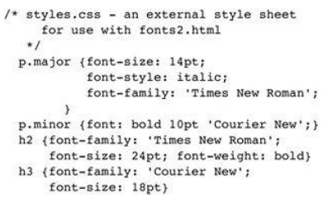
Example - external style sheet

Slide 29
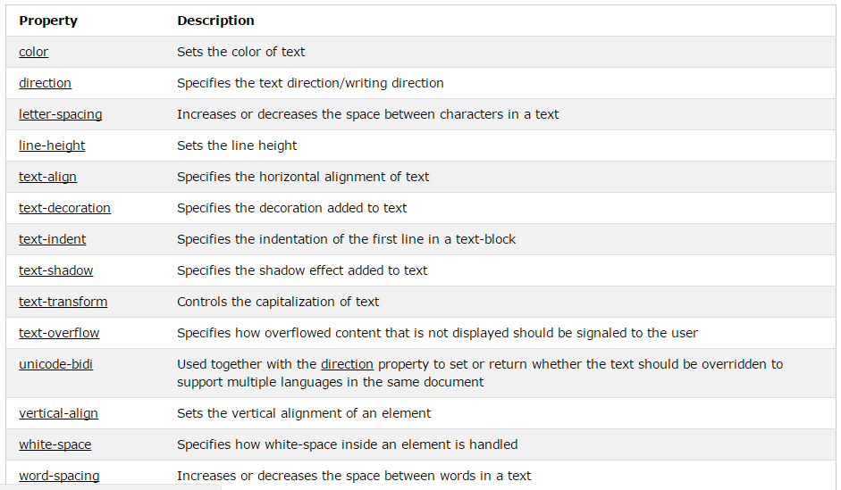
Text decor & alignment
Also, study new CSS3 text properties

Slide 30
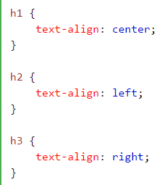
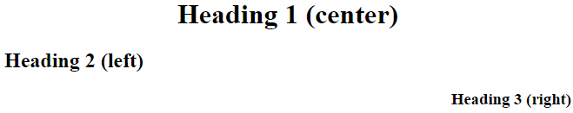
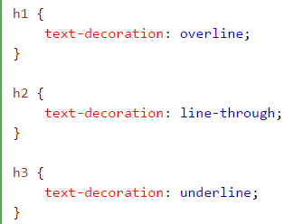
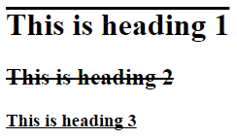
Text

Slide 31
List Properties list-style-type
On unordered lists list-style-type can be used to specify the shape of the bullets
  disc (default), square, or circle
  Set it on either the <ul> or <li> tag
<h3> Fruit </h3>
<ul>
<li style = "list-style-type: disc"> Apple </li>
<li style = "list-style-type: square"> Orange </li>
<li style = "list-style-type: circle"> Pear </li>
</ul>
On ordered lists list-style-type can be used to change the sequence values

Slide 32
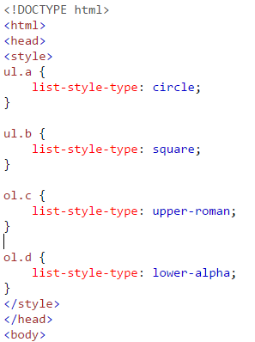
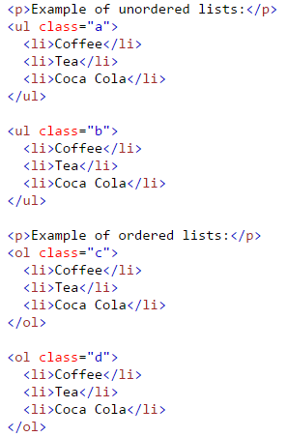
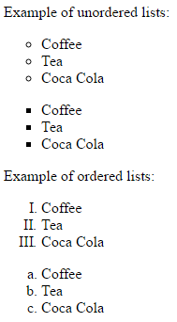

Study CSS Tables Yourself!

Slide 33
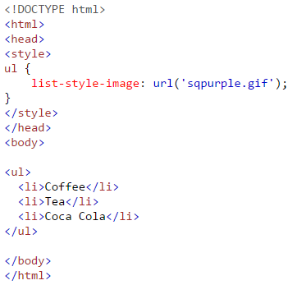

Image List Item Marker
An image can be used in a list item bullet.
Such a bullet is specified with the list-style-image property.
Its value is specified with the url form.

Slide 34
Colors
Colors in CSS are specified by:
  a valid color name - like “red”
  an RGB value - like "rgb(255, 0, 0)“
  a HEX value - like "#ff0000"
The color property specifies color of text
  <style type = “text/css”>
  th.red {color: red}
  th.orange {color: orange}
  </style>
The background-color property specifies the background color of elements

Slide 35
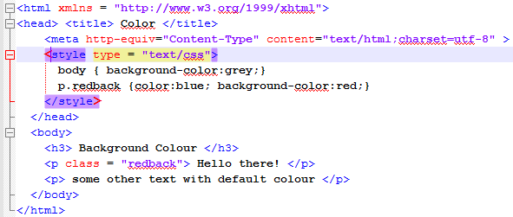
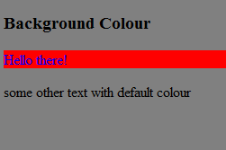
Color…

Slide 36
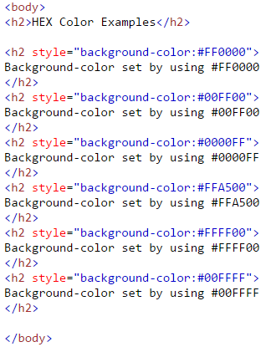
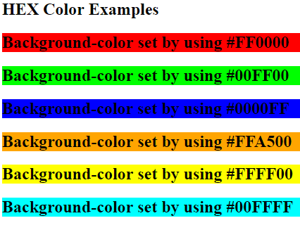

Slide 37
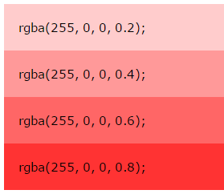
CSS3 Colors
In addition, CSS3 also introduces:
  RGBA colors
  HSL colors
  HSLA colors
  Opacity
Refer w3schools.com
rgba(red, green, blue, alpha) - alpha opacity for a color (0.0 – 1.0)

Slide 38
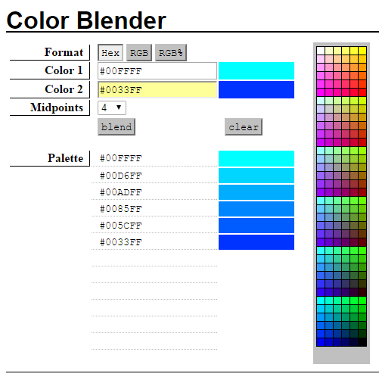
Online color mixers!
Download for offline use

Slide 39
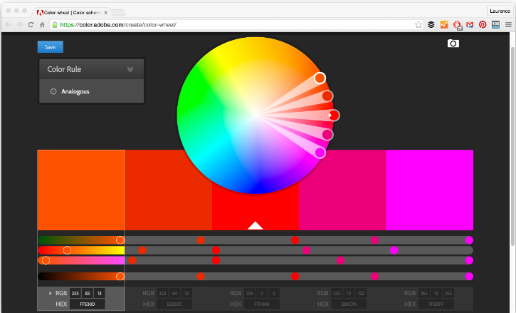
ADOBE KULER: COLOR WHEEL

Slide 40
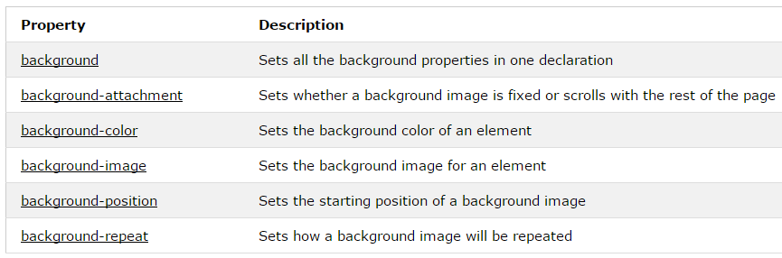

CSS Background image, color
  Possible values: repeat, no-repeat, repeat-x, or repeat-y
  Possible values: top, center, bottom, left, or right
  Used in combination: top left, bottom right,and top center
Shorthand property

Slide 41
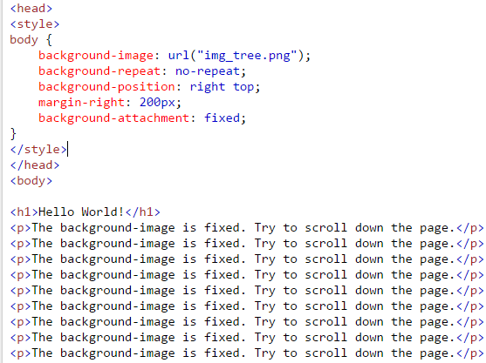
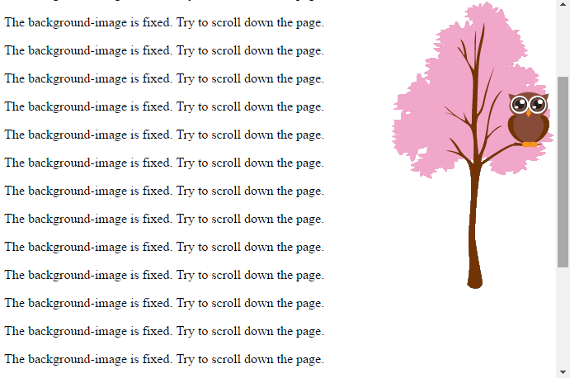
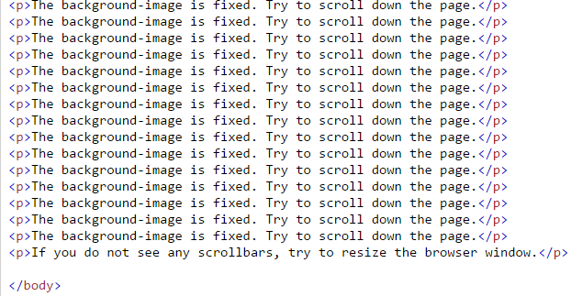

Slide 42

The Box Model
Each element in a document is considered to be a rectangular box consisting of content area, padding, a border and margins
Content - The content of the box, where text and images appear
Padding - Clears an area around the content. The padding is transparent
Border - A border that goes around the padding and content
Margin - Clears an area outside the border. The margin is transparent

Slide 43
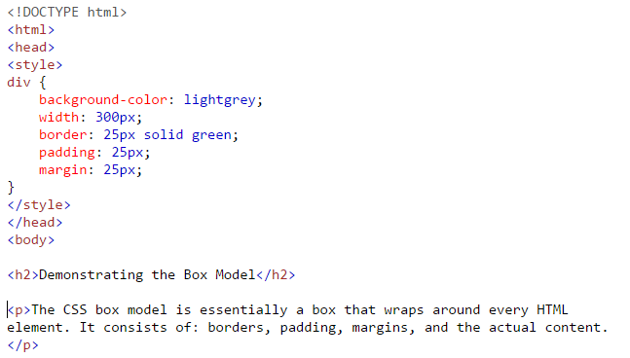
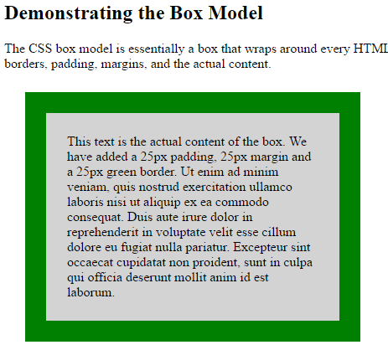
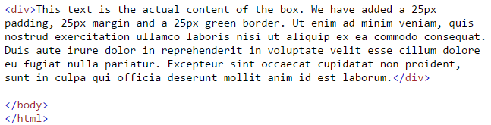
Total element width = width + left padding + right padding + left border + right border + left margin + right margin
Height also calculated in similar way

Slide 44
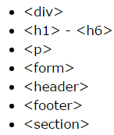

CSS display property
Specifies if/how an element is displayed
The default display value for most elements is block or inline.
Block-level Elements
  starts on a new line and takes up the full width available
Inline Elements
  does not start on a new line and only takes up as much width as necessary.
Block
Inline

Slide 45




Override the default display value
E.g.: Making inline <li> elements for horizontal menus:
Hide an Element - display:none(hides an element, and it will not take up any space) or visibility:hidden(hides an element, but it will still take up the same space as before)

Slide 46
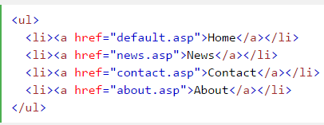
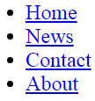
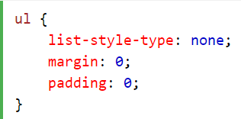
CSS Navigation Bar
Having easy-to-use navigation is very important
With CSS you can transform boring HTML menus into good-looking navigation bars
Navigation Bar = List of Links
  A navigation bar is basically a list of links, use the <ul> and <li> elements
removes the bullets
remove browser default

Slide 47
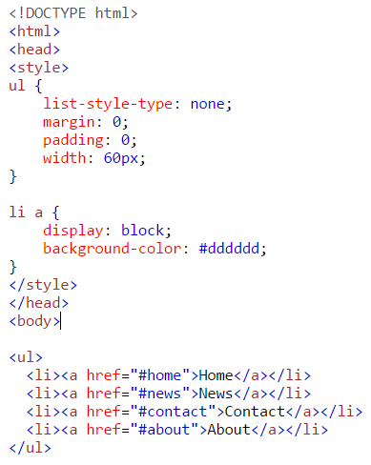


Vertical Navigation Bar
Having easy-to-use navigation is very important
Style the <a> elements inside the list
A background color is added to the links to show the link area.
Notice that the whole link area is clickable, not just the text.

Slide 48
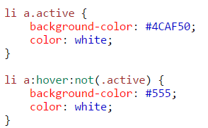
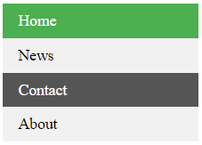
Vertical Navigation Bar
Having easy-to-use navigation is very important
Style the <a> elements inside the list
Active/Current, mouse hover
The definition order must be a:link, a:visited, a:hover and a:active in order to be effective.
You can also add:
hover

Slide 49
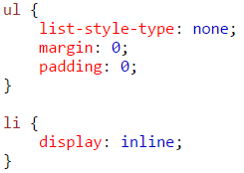
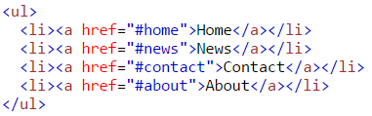

Horizontal Navigation Bar
Two ways to create a horizontal navigation bar:
    inline
    floating list items: use if you want the links to be the same size
Inline List Items:

Slide 50
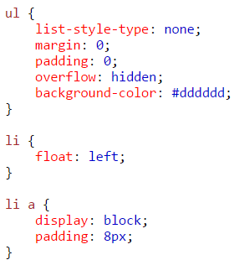
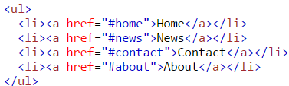
Horizontal Navigation Bar
Floating List Items:
Study different Horizontal Navigation Bar Examples w3schools!

Slide 51
The <span> and <div> tags
One problem with the font properties is that they apply to whole elements, which are often too large
  We want to apply special font properties to less than a whole paragraph of text
Solution: a new tag to define an element in the content of a larger element – <span>
  The default meaning of <span> is to leave the content as it is
<style type = "text/css">
.bigred {font-size: 24pt; font-family: Ariel; color: red}
</style>
…
<p> Now is the <span class = "bigred"> best time </span> ever! </p>

Slide 52
The <span> and <div> tags
The <span> tag is similar to other HTML tags, they can be nested and they have id and class attributes
Another tag that is useful for style specifications: <div>
  Used to create document sections (or divisions) for which style can be specified
  The difference between the <span> tag and the <div> tag is that the <span> tag is used with inline elements whereas the <div> tag is used with block-level elements.
  e.g., a section of five paragraphs for which you want some particular style

Slide 53
Example: <div> tag
  <html>
    <head> <title>HTML div Tag</title> </head>
    <body>
      <!-- First group of tags -->
      <div style="color:red">
        <h4>This is first group</h4>
        <p>Following is a list of vegetables</p>
        <ul>
        <li>Redroot</li>
        <li>Ginger</li>
        <li>Potato</li>
        </ul>
      </div>
      <!-- Second group of tags -->
      <div style="color:green">
        <h4>This is second group</h4>
        <p>Following is a list of fruits</p>
        <ul>
        <li>Apple</li>
        <li>Banana</li>
        <li>Mango</li>
        <li>Strawberry</li>
        </ul>
      </div>
    </body>
  </html>

Slide 54
Example: Layout Using DIV
HTML File
------------------------------------------------------------
<html>
<head>
<title>HTML Layouts using DIV</title>
<link href="sytleEg1.css" type="text/css" rel="stylesheet">
</head>
<body class="body">
<div class="header">
<h1>Main Header</h1>
</div>
<div class="left_content">
<h2><b>Left Menu</b></h2>
<a href="html.html">HTML</a><br />
<a href="php.html">PHP</a><br />
<a href="perl.html">PERL</a>...
</div>
Internet Programming

Slide 55
Example(cont’d)
<div class="main_content">
<p>Usig DIV for layout. This Tutorial....</p>
</div>
<div class="right_content">
<h2><b>Right Menu</b></h2>
<a href="html.html">HTML</a><br />
<a href="php.html">PHP</a><br />
<a href="perl.html">PERL</a>...
</div>
<div class="footer">
<center>
Copyright &copy 2007 xyz.com
</center>
</div>
</body>
</html>
Internet Programming

Slide 56
Example(cont’d)
css File: sytleEg1.css
----------------------------------
body{
background-color: #b5dcb3;
color: #000305;
font-size: 14px;
font-family: Arial, 'Lucidia Sans Unicode';
line-height: 1.5;
text-align: left;
}
.body{ margin: 0 auto; width: 80%; }
.header{ background-color:gray; text-align:center }
.left_content{ background-color:#aaa; height:600px; width:20%;float:left;}
.main_content{background-color:#eee; height:600px; width:60%;float:left;}
.right_content{background-color:#aaa;height:600px;width:20%;float:left;}
.footer{background-color:gray;clear: both;}
Clear: both ---No floating elements allowed on the left or the right side
Internet Programming

